Slide 1
Object Detection and Instance Segmentation
Artificial Intelligence Semester Project

Slide 2
Group 12
Muhammad Ibrahim (BSCS19003)
Muhammad Sufian Saeed (BSCS19013)
Muhammad Muneeb Ur Rahman (BSCS19057)
Moin-ud-din Zulfiqar (BSCS19078)

Slide 3
Content
Introduction to the problem
Introduction to the R-CNN, Fast R-CNN, Faster RCNN (Object Detection)
Introduction to Mask R-CNN (Instance Segmentation)
Methodology and Network Details
Architecture
Mask
RoIPool vs RoIAlign
Bilinear Interpolation
Intersection Over Union (IOU)
Non-maximum Suppression (NMS)
Loss
Training
Testing
Dataset and Accuracy Measure
Results
Other Experiments
Extention to KeyPoint Detection

Slide 4
1. Introduction To Problem
Object Detection and Instance Segmentation are important problems in the Computer Vision Field. It has various applications in reality:
Autonomous Driving Cars
Medicine
Surveillance
Or anywhere where counting object is required.

Slide 5
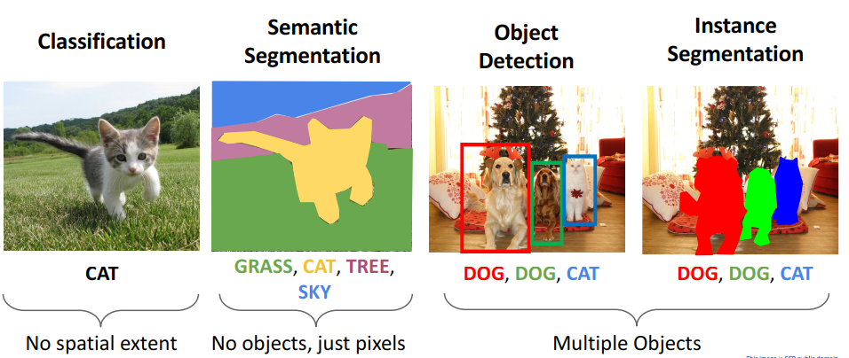
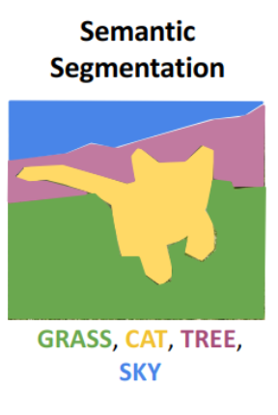
Computer Vision Task

Slide 6
Object Detection and Segmentation Challenges
Multiple Outputs: there are variable number of objects in an image.
Multiple types of Objects: Need to predict “what” (category label) and “where” (bounding box).
Works on large images:
Classification works at 224x224 resolution.
For better object detection we need 800x600 resolution.
Need to predict accurate mask.

Slide 7
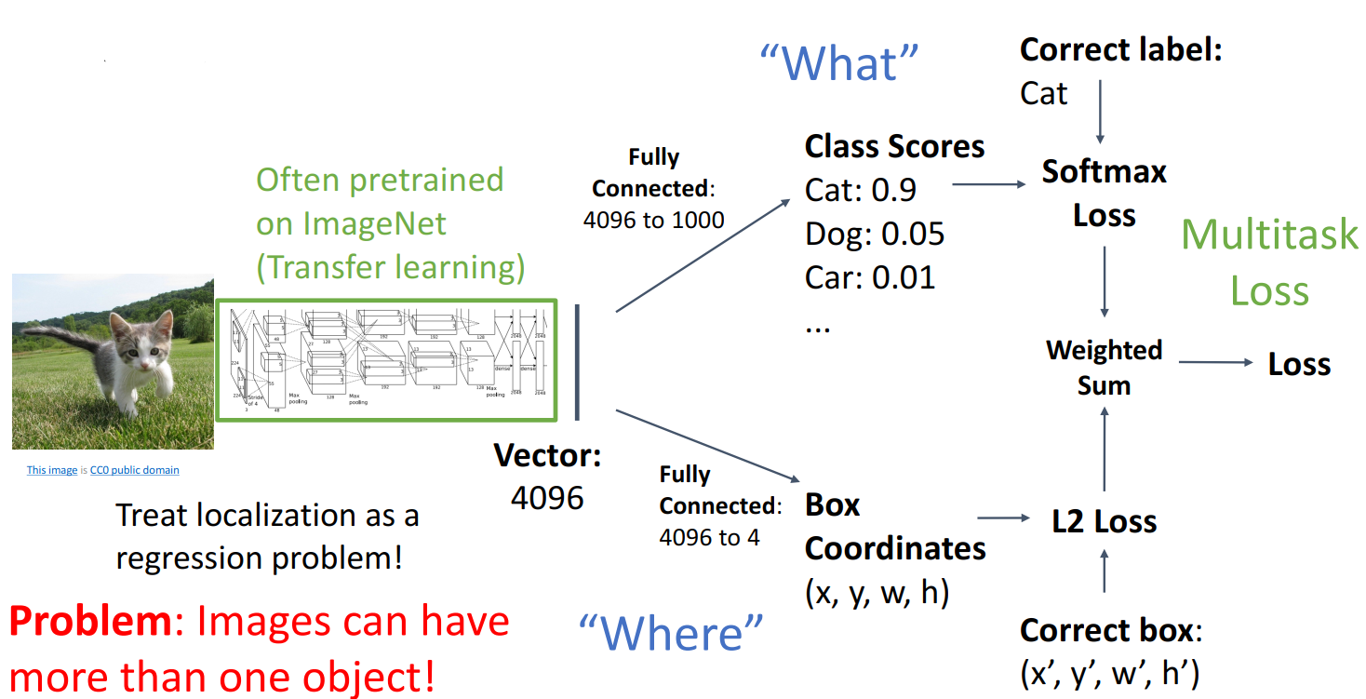
Detecting a single Object

Slide 8
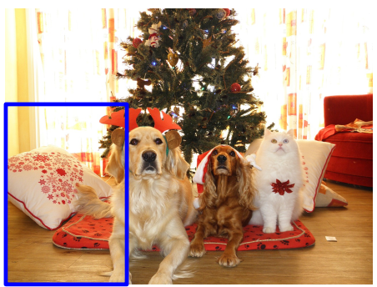
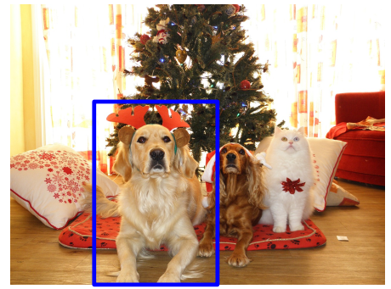
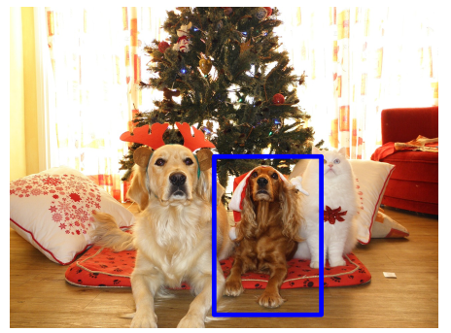
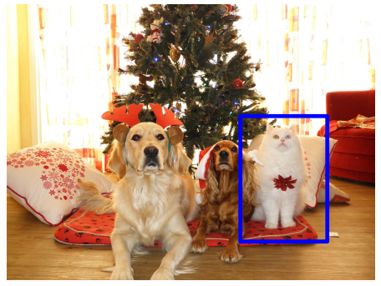
Sliding Window Approach
But the problem remains there, how many boxes do we need??
For 800x600, we basically 58m boxes.

Slide 9
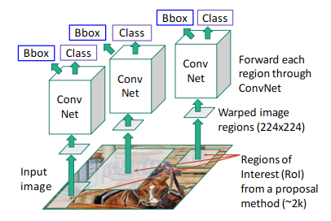
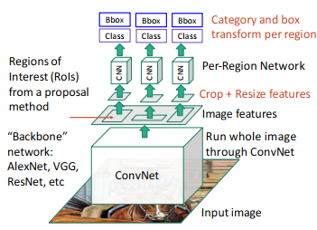
2. Slow and Fast R-CNN
Slow R-CNN/R-CNN
Fast R-CNN

Slide 10
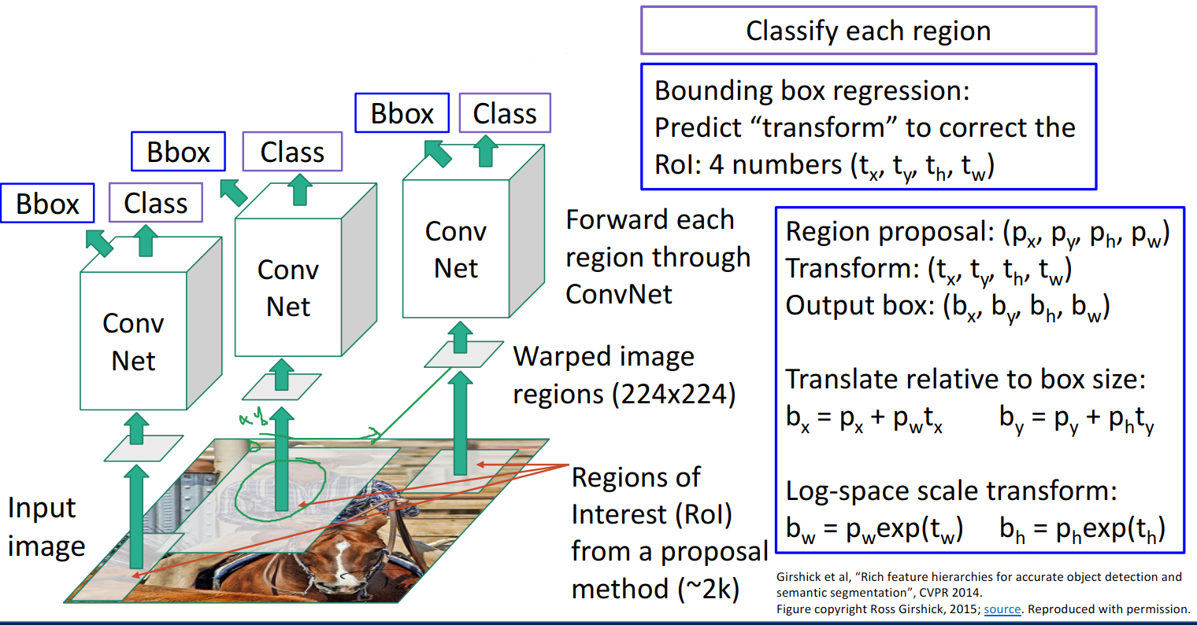
Bounding Box Regression

Slide 11
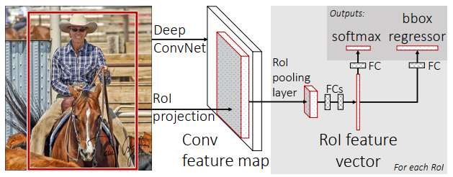
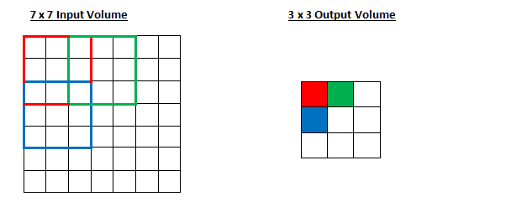
Fast R-CNN
Input region proposals mapped to region proposal on the feature map.
Notes:
https://stackoverflow.com/questions/55488665/whats-the-external-algorithm-used-for-hypothesis-generation-in-fast-r-cnn-and-s

Slide 12
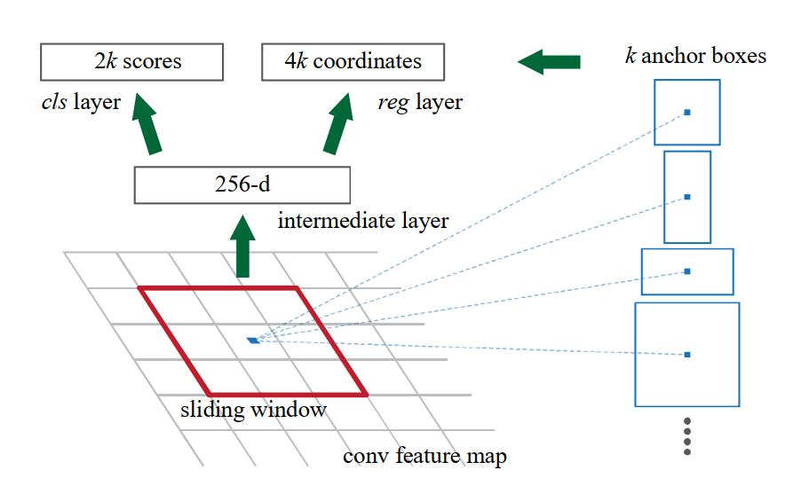
FPN and Anchors
So, the reg layer has 4k outputs encoding the coordinates of k boxes, and the cls layer outputs 2k scores that estimate probability of object or not object for each proposal4.

Slide 13
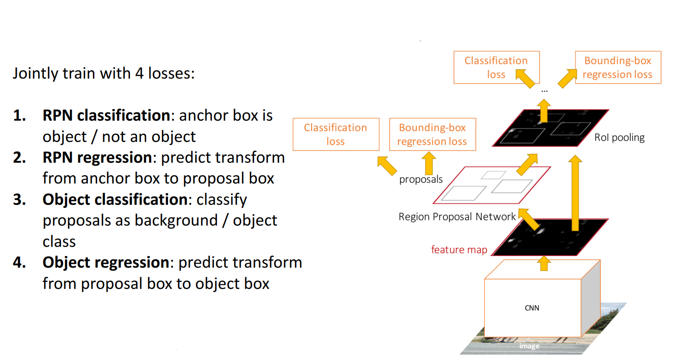
Faster R-CNN

Slide 14
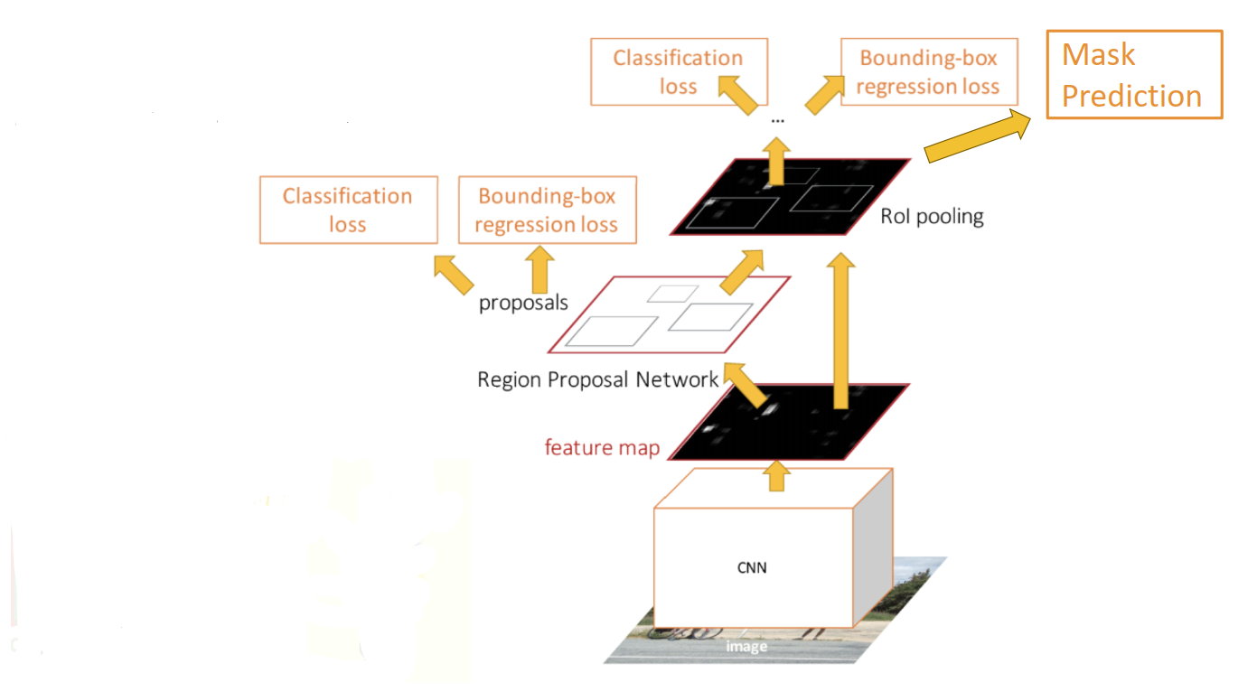
3. Mask R-CNN
Mask R-CNN extend the Faster R-CNN by adding an adding output branch for mask.

Slide 15
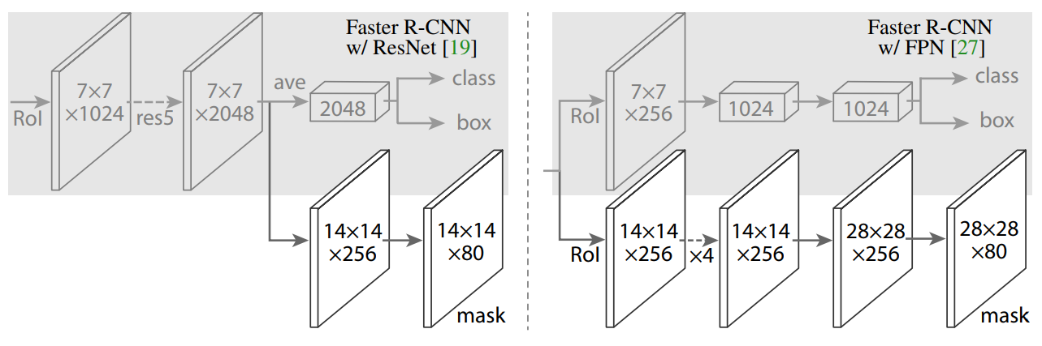
4a. Architecture
Backbones
ResNet50 (ResNet-50-C4)
ResNet101
Feature Pyramid Network (FPN)
Heads
This image shows the architecture head with Faster R-CNN using the ResNet backbone.
This image shows the architecture head with Faster R-CNN using the FPN backbone.

Slide 16
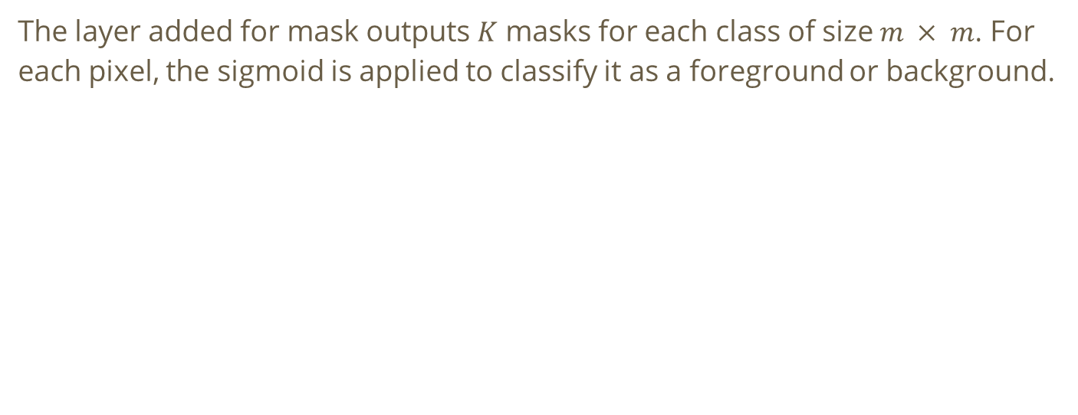
4b. Mask
The layer added for mask outputs $K$ masks for each class of size $m × m$. For each pixel, the sigmoid is applied to classify it as a foreground or background.

Slide 17
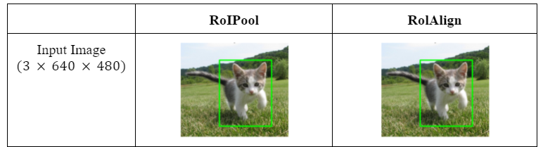
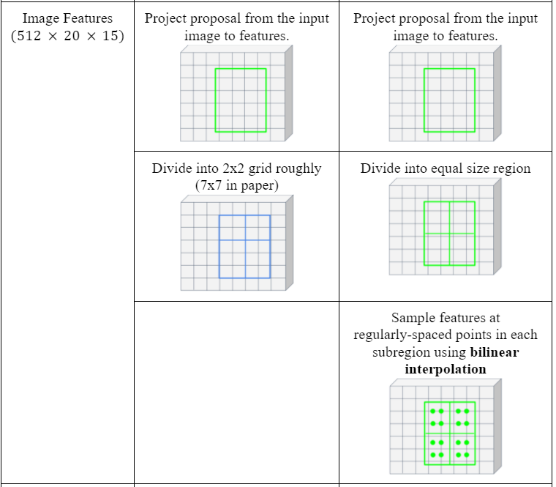
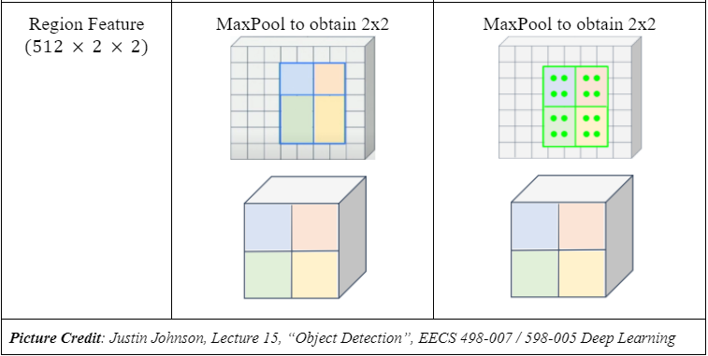
4c. RoIPool vs RoIAlign

Slide 18
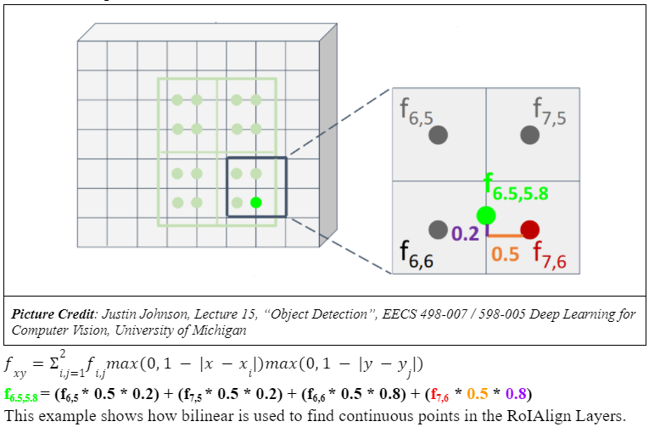
4d. Bilinear Interpolation

Slide 19
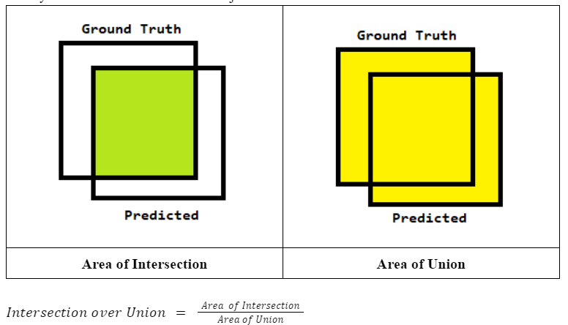
4e. Intersection Over Union (IOU)
Bounding box(bb) has no object:
If IOU<0.5(common) for all the ground truths then bb does not contain any object.
Bounding box contains an object:
If IOU >=0.5(common) then pair the bb with the ground truth which it has maximum IOU.

Slide 20
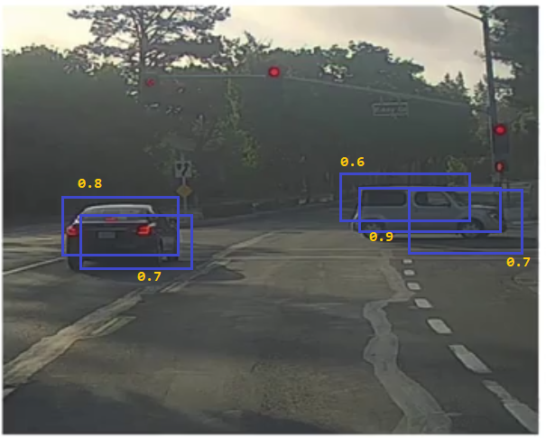
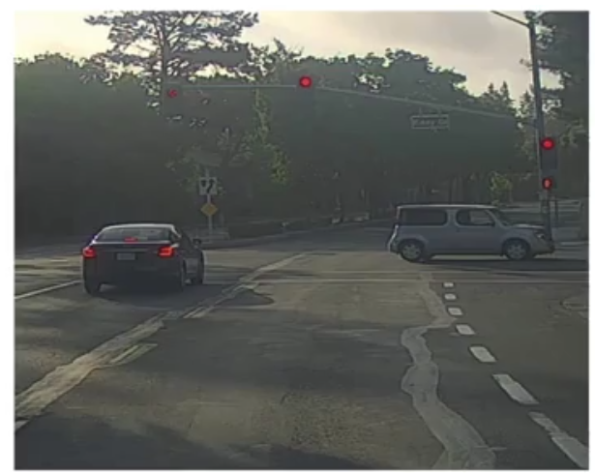
4f. Non-Maximum Suppression
Input to NMS function
1st Iteration
2nd Iteration
Output

Slide 21
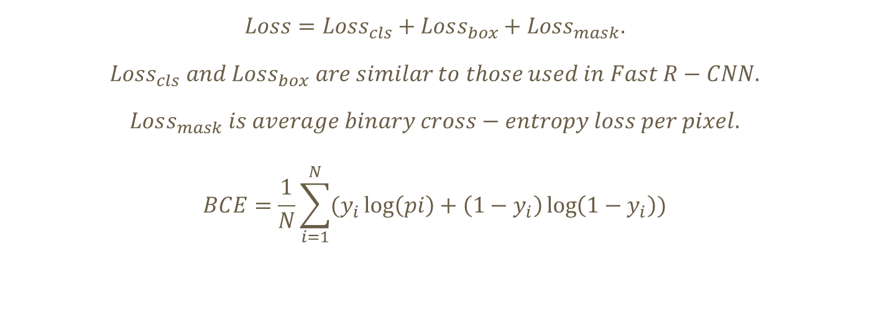
4g. Loss
$$Loss=Loss_{cls}+Loss_{box}+Loss_{mask}.$$
$$Loss_{cls} and Loss_{box} are similar to those used in Fast R−CNN.$$
$$Loss_{mask} is average binary cross−entropy loss per pixel.$$
$$BCE=\frac{1}{N}\sum_{i=1}^{N}{(y_{i}\log\left(pi\right)+\left(1−y_{i}\right)\log\left(1−y_{i}\right))}$$

Slide 22
4h. Training
Images are resized such that their scale (shorter edge) is 800 pixels
Each mini-batch has 2 images per GPU and each image has N sampled RoIs.
N is 64 for the C4 backbone and 512 for FPN
Model is trained on 8 GPUs (so effective minibatch size is 16) for 160k iterations, with a learning rate of 0.02 which is decreased by 10 at the 120k iteration (0.002).
ResNeXt [45], we train with 1 image per GPU and the same number of iterations, with a starting learning rate of 0.01.
The RPN anchors span 5 scales and 3 aspect ratios.

Slide 23
4i. Testing
The proposal number is 300 for C4 backbone and 1000 for FPN.
Box prediction branch runs on these proposals, followed by non-maximum suppression.
The mask branch is then applied to the highest scoring 100 detection boxes.
The sequence of models during testing is Box Predictions → NMS → Mask Branch.
Although this differs from the parallel computation used in training, it speeds up inference and improves accuracy (due to the use of fewer, more accurate RoIs).

Slide 24
5. Datasets
ASCAL Visual Object Classes (VOC) Dataset
VOC2005 to VOC2012.
Contains 20 classes.
Used for object detection, and segmentation.
Used Mean Average Precision (MAP) for Accuracy Measure.
COCO Dataset
Latest Dataset.
Contains almost 80 classes.
Use Average over multiple IOU (AP) for Accuracy Measure.
AP@[.50:.05:.95]: corresponds to the average AP for IoU starting from 0.5 to 0.95 with a step size of 0.05.

Slide 25
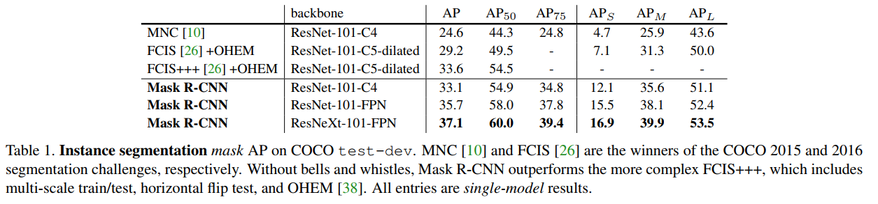
6. Results
Main Results

Slide 26
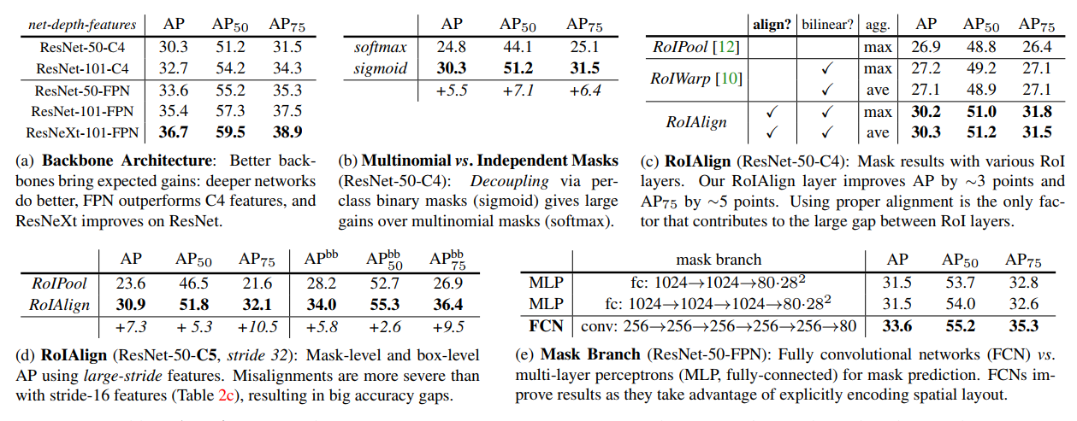
7. Other Experiments

Slide 27
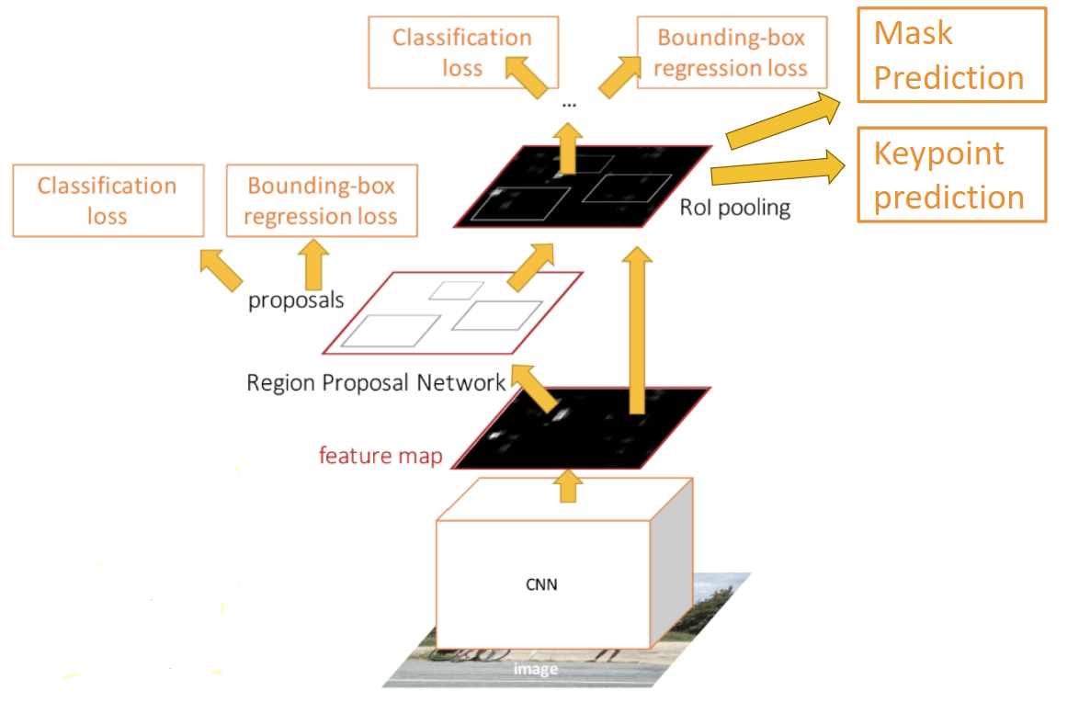
8. Extension To Key Point Detection

